Slide 1


Final Project Respiratory Cancer Survivability
Abdulaziz Almuhaidib

Slide 2


Would early checkup make a huge difference?

Slide 3
Dataset
The dataset used in this project is generated from the surveillance, epidemiology, and end results (SEER) program dataset which contains over 9.5 million records.
Used dataset has 182099 records of patient who have respiratory cancer in the years 2008 to 2012.
13 features including 1 target.

Slide 4
Target
Our target is survivability
If survival month is greater or equal to 60 months and vital status recode is alive:
Then the patient is a survival
Else:
If survival month is less than 60 months and cause of death is respiratory cancer:
Then the patient is not a survival
Else:
Then the patient is died of other cause

Slide 5
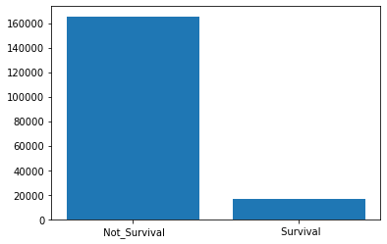
Not Survival = 165,346 Survival = 16,753
Survival Vs. Not Survival

Slide 6
Would early checkup make a huge difference?
We need to look at the percentage of survivability is each stage and each grade.

Slide 7
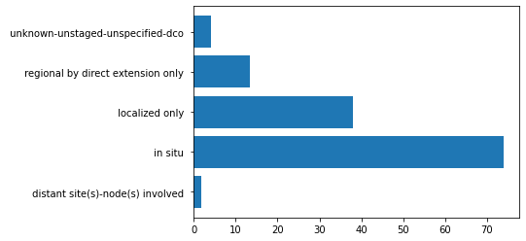
Stage
# | Stage | Percentage
1 | in situ | 73.95%
2 | localized only | 37.96%
3 | regional by direct extension only | 13.3%
4 | distant site(s)-node(s) involved | 1.7%
5 | unknown | 4.05%

Slide 8
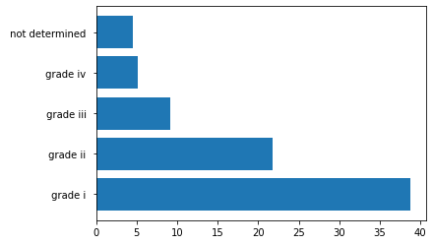
Grade
# | Stage | Percentage
1 | grade i | 38.72%
2 | grade ii | 21.82%
3 | grade iii | 9.08%
4 | grade iv | 5.10%
5 | not determined | 4.5%

Slide 9
Would early checkup make a huge difference?
YES
Stage: 73.95% - 1.7%
Grade: 38.72 – 5.1%

Slide 10
Model Evaluation and Selection
Model | Final random forest | K-Nearest Neighbors
Accuracy | 0.939 | 0.926
10-fold CV

Slide 11
Thank you

